Slide 1
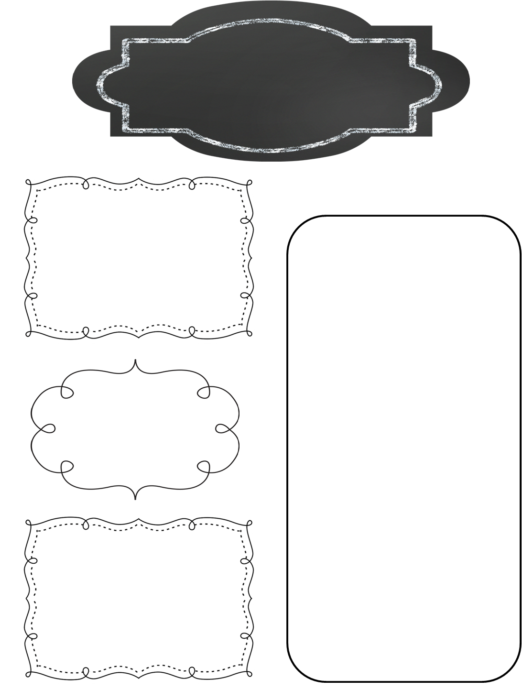
A Peek at This Week in…
Mrs. McFarland’s Class
Week of January 27th
Reminders
We have switched to a 7 day schedule for our reading units. This is in an effort to get in more daily writing. Please consult the online assignment page, your child’s agenda, or this weekly newsletter for information on reading/language/spelling test days. Tests days may not be Fridays.
Math (McFarland)
Order of Operations
Number Expressions
Reading (McFarland)
Unit 3, L#11 (Skills & strategies sheets for the unit were sent home last week.)
Tests next MONDAY!!
Hall of Presidents is coming up quickly—make sure your child knows his/her speech!
Spelling (McFarland)
VCCV pattern
Test next Monday
Language Arts/Writing (McFarland)
Pronouns
Daily Proofreading
Opinion writing
Upcoming Events
Monday, February 3-Friday, February 7: Star Lab
Wednesday, February 12th: Spring Pictures
Friday, February 14th: Manners Meal, Hall of Presidents (8:30-10:30), Valentine’s Day Party
Monday, February 17th: President’s Day –No School
Science/ Social Studies (Eldridge)
Science: N/A
Social Studies: Hall of Presidents reports due Tuesday; speeches due this Friday!

